Slide 1
Algorithms
An algorithm is a set of instructions that enable you, step-by-step, to achieve a particular goal. Computers use algorithms to solve problems on a large scale, as they are able to follow millions of simple instructions per second.
The algorithms you learn in D1 are not conceptually difficult, yet they do represent and give an insight into the tools developed by computer programmers.
This section considers algorithms that:
Sort values into size order
Locate desired values in a list
Maximise usage of materials
All of these require you to follow a few simple steps, but before that we look at algorithms in the form of flowcharts designed to achieve a range of ‘goals’.

Slide 2






Start
Euclid’s Algorithm
The Greek Mathematician Euclid devised an algorithm for finding the Highest Common Factor of 2 numbers:
Eg find the HCF of 240 and 90
a | b | P | q | r | r=0?
240
90
2
180
60
no
90
60
1
60
30
no
60
30
2
60
0
yes
Output = HCF(240,90) = 30
Computers use
algorithms to do
everything!
Is
r = 0?
Yes
Stop
No
This may seem cumbersome, but imagine dealing with very large numbers and introduce a machine that can run the algorithm for you…
Eg find the HCF of 7609800 and 54810068

Slide 3
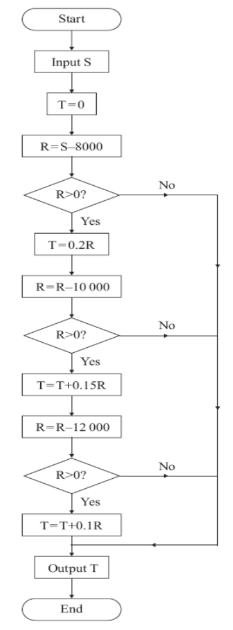



Eg An algorithm is described by the flowchart shown.
(a) Given that S = 25 000, complete the table to show the results obtained at each step when the algorithm is applied.
S | T | R | R > 0? | Output
25000
0
17000
yes
3400
7000
yes
4450
-5000
no
4450
This algorithm is designed to model a possible system of income tax, T, on an annual salary, £S.
(b) Write down the amount of income tax paid by a person with an annual salary of £ 25 000.
£4450
(c) Find the maximum annual salary of a person who pays no tax.
A person pays no tax if when T = 0
So maximum salary is £8000

Slide 4
Eg An algorithm is described by the flowchart shown.
(a) Given that S = 25 000, complete the table to show the results obtained at each step when the algorithm is applied.
S | T | R | R > 0? | Output
This algorithm is designed to model a possible system of income tax, T, on an annual salary, £S.
(b) Write down the amount of income tax paid by a person with an annual salary of £ 25 000.
(c) Find the maximum annual salary of a person who pays no tax.

Slide 5
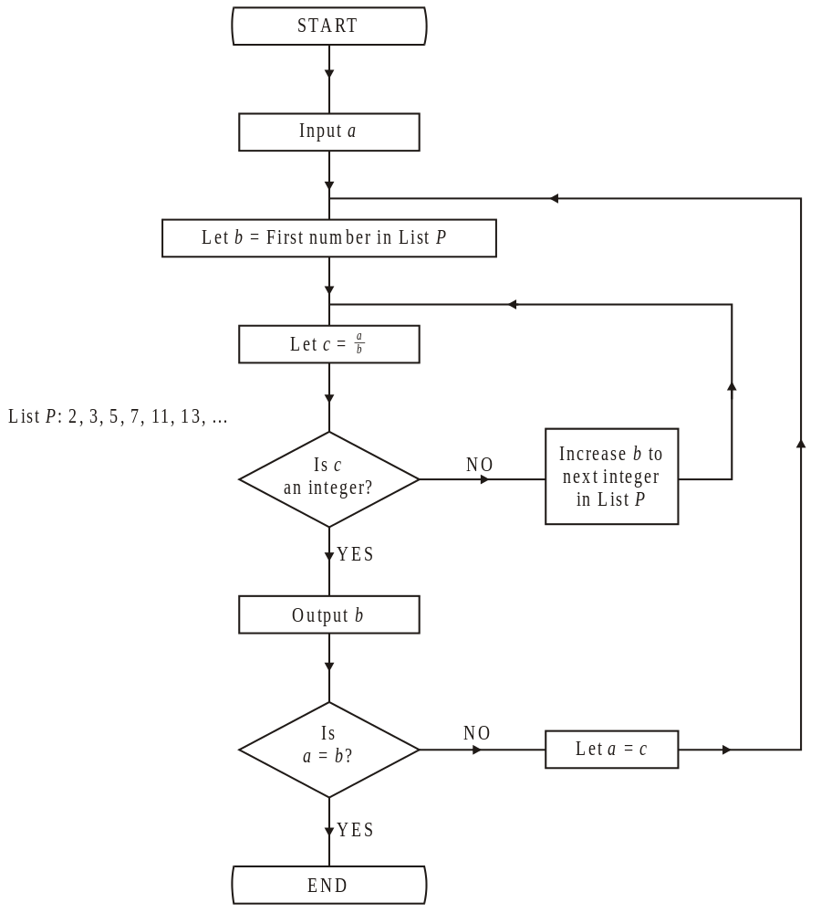
Let P = 2, 3, 5, 7, 11, 13, …
WB1(a) Starting with a = 90, implement this algorithm. Show your working in the table below.
You may not need to use all the rows in this table.
a | b | c | Integer? | Output List | a = b?
90
2
45
y
2
n
45
2
22.5
n
45
3
15
y
3
n
15
2
7.5
n
15
3
5
y
3
n
5
2
2.5
n
5
3
1.66…
n
5
5
1
y
5
y
(b) Explain the significance of the output list.
The prime factors of a
(c) Write down the final value of c for any initial value of a.
1

Slide 6
Bubble sort
A list can also be ordered using a bubble sort, which compares adjacent values sequentially
Eg The list of numbers below is to be sorted into ascending order.
Perform a bubble sort to obtain the sorted list,
giving the state of the list after each completed pass.
45
56
37
79
46
18
90
81
51
45
56
37
79
46
18
90
81
51
45
37
56
46
18
79
81
51
90
37
45
46
18
56
79
51
81
90
37
45
18
46
56
51
79
81
90
37
18
45
46
51
56
79
81
90
Sort complete

Slide 7
Bubble sort
WB3. The list of numbers below is to be sorted into descending order.
Perform a bubble sort to obtain the sorted list, giving the state of the list after each completed pass.
52 48 50 45 64 47 53
52
48
50
45
64
47
53
52
50
48
64
47
53
45
52
50
64
48
53
47
45
52
64
50
53
48
47
45
64
52
53
50
48
47
45
Sort complete

Slide 8
Quick sort
A list can be ordered using a quick sort, which splits the list to obtain pivots
45 32 51 75 56 47 61 70 28
The list of numbers above is to be sorted into ascending order.
Perform a Quick Sort to obtain the sorted list, giving the state of the list after each pass, indicating the pivot elements.
45 32 51 75 56 47 61 70 28
45
32
51
47
28
56
75
61
70
45
32
47
28
51
61
75
70
45
32
28
47
70
75
28
32
45
75
28
45
Why do you think it is called a quick sort?
Sort complete

Slide 9
WB2a) The following list gives the names of some students who have represented Britain in the International Mathematics Olympiad.
Roper (R), Palmer (P), Boase (B), Young (Y), Thomas (T), Kenney (K), Morris (M), Halliwell (H), Wicker (W), Garesalingam (G).
(a) Use the quick sort algorithm to sort the names above into alphabetical order.
R P B Y T K M H W G
B
H
G
K
R
P
Y
T
M
W
B
G
H
R
P
M
T
Y
W
B
G
M
P
R
W
Y
B
M
R
Y
Sort complete

Slide 10
The list of numbers below is to be sorted into asscending order.
Perform:
a bubble sort to obtain the sorted list, giving the state of the list after each completed pass.
a quick sort to obtain the sorted list, giving the state of the list after each completed pass.
8 4 13 2 17 9 15
Quick sort
Bubble sort
8 4 13 2 17 9 15
8 4 13 2 17 9 15
2 8 4 13 17 9 15
4 8 2 13 9 15 17
8 4 13 9 15 17
4 2 8 9 13 15 17
8 4 9 13 15
4 8 9 15
2 4 8 9 13 15 17
8 9
8

Slide 11
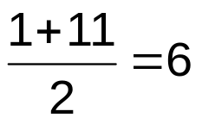

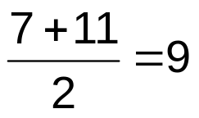

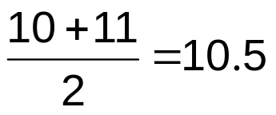


Binary Search
Desired values in a list can be located using a binary search, which uses a process of elimination to find the value
Eg A list of numbers, in ascending order, is
7, 23, 31, 37, 41, 44, 50, 62, 71, 73, 94
Use the binary search algorithm to locate the number 73 in this list.
1st
7
2nd
23
Reject 7 to 44
3rd
31
4th
37
5th
41
Reject 50 to 71
6th
44
7th
50
Reject 94
8th
62
9th
71
Leaving
Number found, search complete
10th
73
11th
94

Slide 12
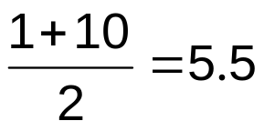

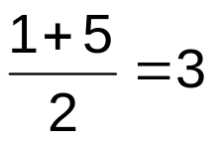

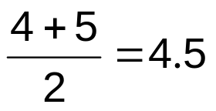


Binary Search
WB2b) The following list gives the names of some students who have represented Britain in the International Mathematics Olympiad.
Use the binary search algorithm to locate the name Kenney
1st
Boase (B)
2nd
Garesalingam (G)
Reject P to Y
3rd
Halliwell (H)
4th
Kenney (K)
Reject B to H
5th
Morris (M)
6th
Palmer (P)
7th
Roper (R)
Reject M
8th
Thomas (T)
Leaving
Name found, search complete
9th
Wicker (W)
10th
Young (Y)

Slide 13
Bin Packing: first fit decreasing
Suppose you need some expensive wood, in various lengths, for a DIY project.
It only comes in set lengths and you want to minimise the number of lengths you buy and therefore minimise the total cost. Bin packing can be used to do this.
WB4 Nine pieces of wood are required to build a small cabinet. The lengths, in cm, of the pieces of wood are listed below.
20, 20, 20, 35, 40, 50, 60, 70, 75
Planks, one metre in length, can be purchased at a cost of £3 each.
The first fit decreasing algorithm is used to determine how many of these planks are to be purchased to make this cabinet. Find the total cost and the amount of wood wasted.
Planks of wood can also be bought in 1.5 m lengths, at a cost of £4 each.
The cabinet can be built using a mixture of 1 m and 1.5 m planks.
b) Find the minimum cost of making this cabinet. Justify your answer.

Slide 14

Bin Packing
20, 20, 20, 35, 40, 50, 60, 70, 75
Bin
Lengths of wood
Waste
To see if a solution is optimal:
calculate the total of all values
1
5
75
60
70
40
50
35
20
20
20
divide this by the bin capacity
2
10
round to the next integer
3
0
If optimal, this value matches the number of bins you used
4
15
If value is smaller, the solution may not be optimal
5
80
Amount needed = 390
Bin capacity = 100
Total waste = 110cm
So minimum 4 bins required
Total cost = 5 x £3 = £15
Solution may not be optimal

Slide 15
Bin Packing
There are 3 bin packing algorithms you must be able to apply:
8 7 14 9 6 9 5 15 6 7 8
Eg The numbers represent the lengths, in cm, of pieces to be cut from 20cm rods
First-fit
First-fit decreasing
Full-bin
Bin
Lengths
15
14
9
9
8
8
7
7
6
6
5
8
7
14
9
6
9
5
15
6
7
8
1
8
7
5
Bin
Lengths
Bin
Lengths
2
14
6
1
15
5
1
15
5
15 + 5 = 20
3
9
9
2
14
6
2
14
6
14 + 6 = 20
4
15
3
9
9
3
7
7
6
7 + 7 + 6 = 20
5
6
7
4
8
8
4
8
9
6
8
5
7
7
6
5
9
8
Fit values into the first bin with enough space
Put values in descending size order, then apply first-fit algorithm
Group values into totals to fill bins, then apply first-fit algorithm
Which is best?
There is no guarantee that any of the algorithms will give an optimal solution, but the full-bin method is most likely to be optimal and the first-fit method is least likely.

